Slide 1


Event Handling

Slide 2
An event is an action initiated by the user interacting with the program. Examples - Keyboard events – pressing, holding, releasing - Mouse events – moving, clicking - GUI events – clicking a button, resizing a window, closing a window. An event in java is an object of a particular event class, that represents some user actions to which the GUI might respond’. Most often events correspond to user actions, but sometimes they do not.

Slide 3
Low level events: Low level events represent direct communication from the user. Low level event examples: - Key event - focus event - mouse event - container event - component event - paint event

Slide 4
High level events High level events usually involve one or more low level events. High level events examples: - action event - adjustment event - item event - text event

Slide 5
How do the low and high level events work in java? When the user clicks the mouse on a button, then releases it, the button gets two or three separate, low level mouse events. - One for mouse down - One for mouse up - Possibly one for mouse drag However, the button then fires one high level event - ActionEvent.

Slide 6
java.awt.event.*
ActionEvent
AdjustmentEvent
ComponentEvent
ItemEvent
TextEvent
ContainerEvent
FocusEvent
InputEvent
PaintEvent
WIndowEvent
KeyEvent
MouseEvent

Slide 7
User Action
Event Object
Activate an event
Generate an event
Notify LIstener
Source Object
Listener Event
Register a listener object
Event handler
Java event Delegation Model()
Java uses delegation-based model for event handling.
Java uses event listener to register an event and event handler to respond to the event.
The use of event listeners in event handling is called delegation event model.

Slide 8
Event sources
The type of an event depends on its source
Eg: the keyboard, mouse, GUI components – buttons, text felids, windows
Event source is an object with the ability to determine when an event has occurred.
An event source generates events by invoking methods
Listeners:
Listeners wait for events to occur. A listener object is an instance of a class that implements a specific listener interface.
Listeners must register to source.
Whenever an event is generated that particular listener will be activated, and to the listener will execute the event, with the help of the particular interface.

Slide 9
Class Events Interface
Action Event Button , Menu Item, List Action Listener
Adjustment Event Component Adjustment Listener
Component Event Component Component Listener
Container Event Component Container Listener
Focus Event Component Focus Listener
Item Event Checkbox, Choice Item Listener
Key Event Text Component Key Listener
Mouse Event Mouse movements Mouse Listener
Mouse Wheel Event Mouse wheel Movement Mouse wheel Listener
Text Event Text component Text Listener
Window Event Window Window Listener

Slide 10
These events will be handled by the listeners with the help of these interfaces.
For this to happen,
Listeners must register to sources.
To register the listener interface to the source
addTypeListener()
Example:
for keylistener to register with source : addKeyListener()
buttonlistener to register with source : addActionListener()

Slide 11
Interface Methods
Action Listener actionPerformed()
Adjustment Listener adjustmentValueChanged()
componentResized()
Component Listener componentMoved()
componentShown()
componentHidden()
Container Listener componentAdded()
componentRemoved()
Focus Listener focusGained()
focusLost()
Item Listener itemStateChanged()
keyTyped()
Key Listener keyPressed()
keyRelesed()

Slide 12
Interface Methods
mousePressed()
mouseEntered()
MouseListener mouseClicked()
mouseExited()
mouseReleased()
Mouse Motion Listener mouseMoved()
mouseDragged()
Mouse wheel Listener mouseWheelMoved()
Text Listener textChanged()
windowActivated()
windowDeactivated()
windowOpened()
Window Listener windowClosed()
windowIconified()
windowDIiconfied()

Slide 13
ActionEvent
The ActionEvent class contains specific information about the event that occurred.
An action event occurs whenever an action is performed by the user.
- click on a button action event takes place.
- when you double click on the text field actin event occur.
click
jTextfields

Slide 14
import java.awt.*;
import java.awt.event.*;
public class ActionListenerExample implements ActionListener{
public static void main(String[] args) {
Frame f=new Frame("ActionListener Example");
final TextField tf=new TextField();
tf.setBounds(50,50, 150,20);
Button b=new Button("Click Here");
b.setBounds(50,100,60,30);
b.addActionListener(this);
f.add(b);f.add(tf);
f.setSize(400,400);
f.setLayout(null);
f.setVisible(true);
}
public void actionPerformed(ActionEvent e){
tf.setText("Welcome to Javatpoint.");
}
}

Slide 15
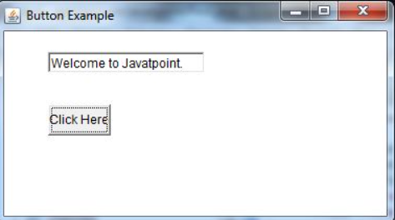

Slide 16
Item Listener:
It is mainly used for item selection, and it is an interface that listens for the item event.
The java ItemListener notifies each and every click on the checkbox, and it let you know against the item event.

Slide 17
import java.awt.*;
import java.awt.event.*;
public class ItemListenerExample implements ItemListener{
Checkbox checkBox1,checkBox2;
Label label;
ItemListenerExample(){
Frame f= new Frame("CheckBox Example");
label = new Label();
label.setAlignment(Label.CENTER);
label.setSize(400,100);
checkBox1 = new Checkbox("C++");
checkBox1.setBounds(100,100, 50,50);
checkBox2 = new Checkbox("Java");
checkBox2.setBounds(100,150, 50,50);
f.add(checkBox1); f.add(checkBox2); f.add(label);
checkBox1.addItemListener(this);
checkBox2.addItemListener(this);
f.setSize(400,400);
f.setLayout(null);
f.setVisible(true);
}

Slide 18
public void itemStateChanged(ItemEvent e) {
if(e.getSource()==checkBox1)
label.setText("C++ Checkbox: "
+ (e.getStateChange()==1?"checked":"unchecked"));
if(e.getSource()==checkBox2)
label.setText("Java Checkbox: "
+ (e.getStateChange()==1?"checked":"unchecked");
}
public static void main(String args[])
{
new ItemListenerExample();
}
}

Slide 19
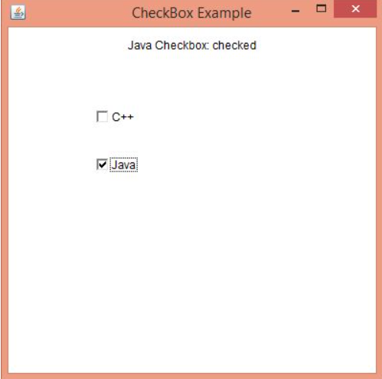

Slide 20
Input Listener():
Input Listener
KeyEvent
MouseEvent

Slide 21
KeyEvent
A KeyEvent is generated when keyboard input occurs. There are three types of key events, which are identified by these integer constants:KEY_PRESSED, KEY_RELEASED, and KEY_TYPED. The first two events are generated when any key is pressed or released. The last event occurs only when a character is generated. Remember, not all keypresses result in characters. For example, pressing shift does not generate a character.
MouseEvent
There are eight types of mouse events. The MouseEvent class defines the following integer constants that can be used to identify them:
MOUSE_CLICKED : The user clicked the mouse.
MOUSE_DRAGGED : The user dragged the mouse.
MOUSE_ENTERED : The mouse entered a component.
MOUSE_EXITED : The mouse exited from a component.
MOUSE_MOVED : The mouse moved.
MOUSE_PRESSED : The mouse was pressed.
MOUSE_RELEASED : The mouse was released.
MOUSE_WHEEL : The mouse wheel was moved.

Slide 22

Thank You!

